Slide 1
College 101:
For Seniors
and Families

Slide 2
What is Most Important to You?
What are my reasons for going to college? What are my long terms goals?
Where do I see myself? 2 or 4 year institution? Small or large school?
Do I want to stay close to home or am I prepared to visit my family only a few times a year?
Have my grades been high enough to be considered by a very selective school?
Do I want a demanding academic environment?
How important will cost be in my final choice?
Notes:
Our philosophy is student-centered and to put the student in charge of their own process

Slide 3
Where do I apply?
“Reach” schools: If your test scores/GPA are not within the middle 50% of last year’s admitted class, the school is considered a reach. Any school with an admission rate of under 10-15% is considered a reach even if you have a 4.0 GPA and perfect test score.
*If you fall under the middle 50% of last years admitted class, it is beneficial to submit an essay even if it is optional.
“Match” schools: Meet the entrance/admission requirements, but the school is considered selective
“Probable” schools: Meet or exceed the entrance/admission requirements and selectivity process

Slide 4
Planning Calendar
September-November: College visits, complete applications, attend college fairs, request letters of recommendation, write essay(s)
December-January: FAFSA, Mid-year reports for Common Application
February-March: Scholarships, financial aid letters
May 1st: College Decision Deadline
May 5th-May 16th: AP Exams
APPLY
EARLY!

Slide 5
Student Responsibilities
Own your process
Review resources
Complete applications
Follow deadlines, admission requirements, policies and guidelines
Request and/or submit required materials
Check status of application once submitted

Slide 6
Role of the Counselor
Advise on post-secondary search
Review essays and applications with students
Complete required and/or recommended supplemental materials
Collaborate with advisors and faculty
Discuss standardized testing options
Oversee submission of school records

Slide 7
Colleges visiting U-High
College Visit Tuesday- Each week (9/17-10/29) we will host up to 4 college/university representatives. All visits will be held in the Library.
Complete the College Representative Visit form on the U-High website
You are responsible for any missed class time, materials and assignments

Slide 8
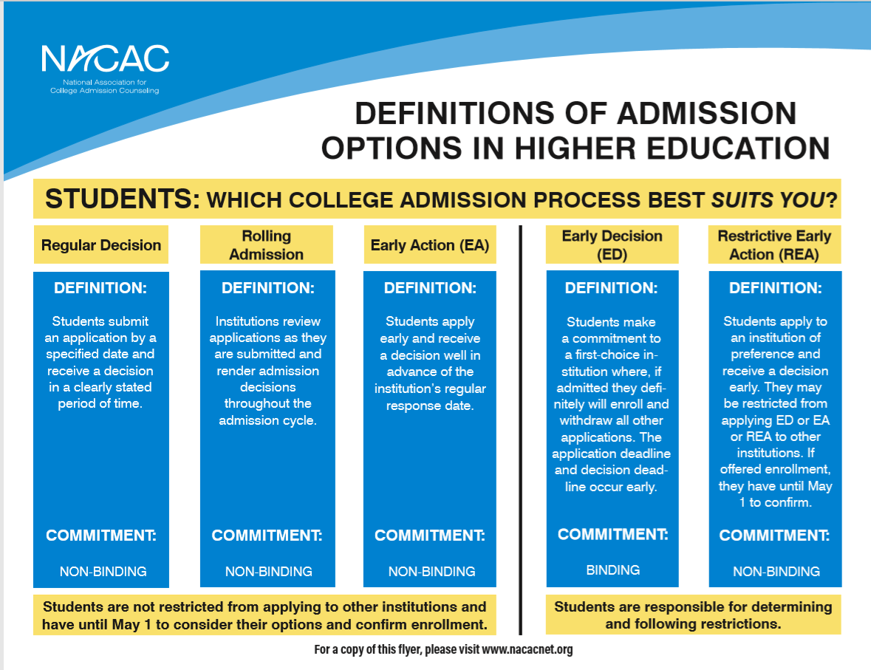
Admission deadlines

Slide 9
Ethical Responsibilities
The student is responsible for notifying colleges if an academic class was dropped after the transcript was submitted
Comply with Early Decision or Restrictive Early Action policies
All information reported (including self-reported grades and test scores) is truthful and accurate
May 1st is the deadline to let colleges know you will be attending, and make a deposit to one institution

Slide 10
What is included in a college application?
Student
U-High
Counselor
Teacher
Application- includes academics, essays and activities
Test scores- if required (sent from College Board/ACT)
Payment- cost varies
Invitations to counselor/teacher
Transcript (we do not rank) and School Profile
Secondary School Report
Counselor Recommendation
Teacher Recommendation (if required)

Slide 11
AP/Dual Credit Transferability
No set standard
Example:
  AP Calculus
    ISU: 3, 4, 5 - Math 145 (4 credits)
** Refer to Counseling website for more information
College Board AP Credit Search

Slide 12
Common App
Gather materials: transcript, list of activities, work, family responsibilities, test scores (with dates), parent/guardian information, academic honors and achievements.
Create an account
Add Colleges: View “Dashboard” and “My Colleges”. Add up to 20 colleges, and you can adjust them at any time. Once you hit submit, you cannot remove any schools from your list.
Engage Supporters: All colleges need official school forms. Many will ask for letters of recommendation. Counselors, teachers, and recommenders will submit forms on your behalf. Every college chooses their own recommendation requirements. You can find details on each college’s “College Information” page.
Understanding Requirements: Each college needs you to complete common questions and add counselor. Beyond that their applications vary. Each college can determine their unique requirements for: deadlines, application fees, personal essays, courses and grades, test policy, portfolio, writing supplements, and recommendations.
Plan Essays: Can feel like the biggest part of your application. As you work on your applications, you can find essays or short answer questions in 3 sections- Common App Personal Essay, College-specific questions, writing supplements.
Submit your Application: 3-step process (Review your application, pay the fee, submit your application).

Slide 13
Requesting Transcripts
All seniors should have received an email on August 19th with instructions on steps to take to request transcripts from Parchment.

Slide 14
Mid-year and Final Transcripts
Mid-year (1st semester grades)
The Counseling Office will automatically send mid-year reports through the Common Application in late January. If you did not apply through the Common Application, and need us to send your 1st semester grades, please contact your counselor.
Final Transcripts
The Counseling Office will automatically send all final transcripts after students completed the post-high school plans survey in April.

Slide 15
Letters of Recommendation
Check each school’s website for specific requirements
Look to see what is required vs. optional
Do not send letters for colleges that do not ask for them
Complete the Brag Sheet
Give your recommender a minimum of 2 weeks to complete
Ask…..
A teacher, coach, club sponsor, etc. from junior year (who knows you well and can speak to both your academic and personal strengths
A teacher directly if they will write you a letter

Slide 16
Essays and Interviews
Start early
Be yourself
Be honest
Stay focused
Put your best foot forward
Get a second opinion
Proofread
Do research prior to the interview
Be prompt
Be neat- dress appropriately
Be prepared- Mock interview
College Essay Guy- 5 things that work well and 5 things that don’t work when writing your college essay
https://www.youtube.com/watch?v=xhl-zBqol00

Slide 17
Scholarships
College/university scholarships
Local, state, national scholarships on U-High counseling website
U-High scholarships- available in March
National searches

Slide 18
Helpful Resources
U-High Website: Academics/Counseling
Google Classroom- Join Class of 2025 Class code is caxjhrt
Net Price Calculator: Available on every institution’s website
College Scorecard: Compare colleges, programs, costs, admissions, and more
College Search: Big Future
Financial Aid: www.FAFSA.gov, CSS Profile,
Scholarships: www.scholarships.com, fastweb.com, finaid.org, www.goingmerry.com, College Board

Slide 19
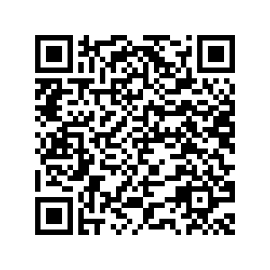
Upcoming Events
FAFSA Workshop- Wednesday, January 15th in U-High Library
College Night- More information coming soon
Greater McLean County College Fair- Tuesday, October 1st, 5:30-7pm at Illinois State University
NACAC College Fairs (in-person and virtual)- In Chicago on 10/5 from 11am-3pm and in St. Louis on 10/27 from 1pm-4pm
Virtual- 9/15, 10/16, and 11/3 from 12-5 (CT)
Meeting with Mrs. O’Connor- Please schedule a time to meet to discuss your post-graduation plans, get assistance, and ask questions

Slide 20
Thank you for coming!
Mrs. Courtney O’Connor Mr. Travis Millard
College and Career Counselor Registrar
309-438-5693 309-438-5691
clocon2@ilstu.edu tkmilla@ilstu.edu
Mrs. Carrie Hoffman
School Counselor A-K ISAC Representative
309-438-8154 Anja Schrag
choffm2@ilstu.edu Anja.Schrag@Illinois.gov
Mr. Chris Headrick
School Counselor L-Z
309-438-5520
cheadri@ilstu.edu

